Slide 1



Health Care
Analysis

Slide 2

Objective Of
Project
Analysing Hospital Data
Identifying Patient Trends
Tracking Number of patients visits hospital
Comparing Each Department Performance
Understanding Data By using Dashboards

Slide 3

KPI’s Used
Total Patients
Total Visitors
Total Revenue

Slide 4
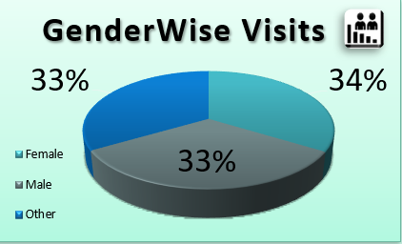

Q1. Which Gender Visits More Hospitals and Why
Women occupy 34% of total hospital visits, which is the highest because females mostly require regular health checkups, gynecology-related consultations, and pregnancy-related care.

Slide 5
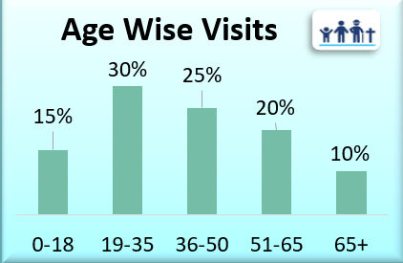
Q2. Which Age Group Heighest Hospital Visits &Why
The age group 19–35 occupies 30% of total visits, because this group is more active, faces lifestyle issues, work stress, and accident-related admissions.

Slide 6
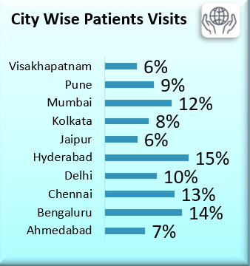
Q3.Which City Has Maximum Patient Count
Hyderabad occupies 15% of total patient visits, because it is a highly populated metro city with better hospital accessibility and higher healthcare demand.

Slide 7
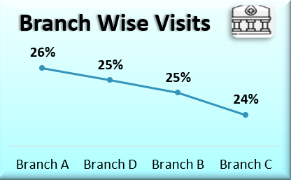
Q4. Which Branch is Performing Better in Terms of Patient Handling & Why
Branch A occupies 26% of total patient handling, which shows it is performing better due to higher patient inflow capacity, strong infrastructure, and efficient management.

Slide 8
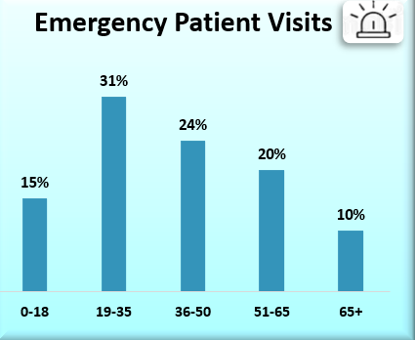
Q5.Which Age Group is Most Likely to Take Emergency Admission
The 19–35 age group occupies 31%of total emergency admissions, because young adults face more road accidents, work pressure, and sudden health-related emergencies.

Slide 9
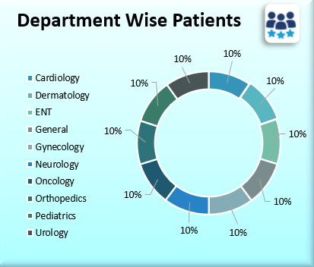
Q6. Which Department Recevies The Heighest Number Of Admission & Why
Neurology occupies 10% of total admissions, because neurological cases like stroke, migraine, seizures are critical and often require immediate hospitalization

Slide 10
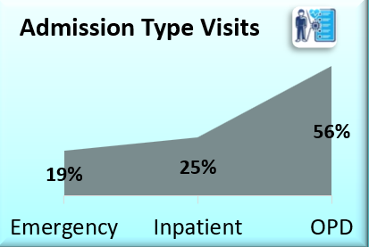
Q7.Which Type Of Admission Patients Visits Most
OPD Admission Occupies 56% ,OPD cases Visits Most

Slide 11
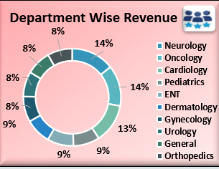
Q8. Which department generates the highest treatment cost and why?
Neurology and Oncology generates the highest revenue by contributing 14%of total revenue
because neurology cases require costly diagnostics (MRI/CT), ICU care, and high-end procedures.

Slide 12
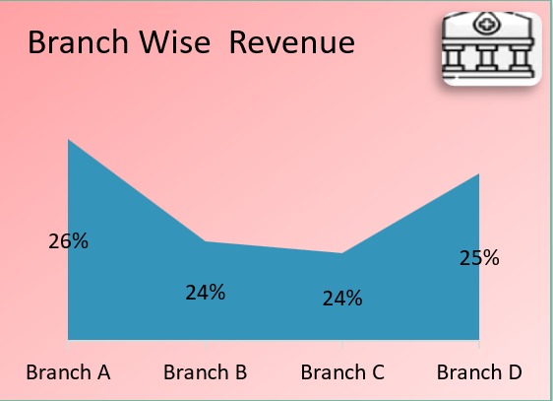
Q9. What is the total treatment revenue by hospital branch?
Branch A generates the maximum revenue by contributing 26% of total revenue.

Slide 13
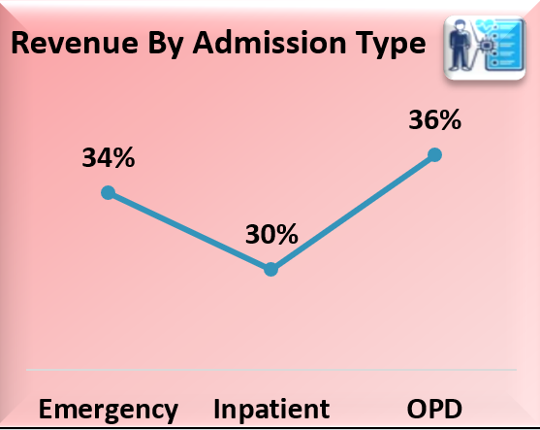
Q10. Which admission type (OPD/Emergency/Inpatient) is most expensive?
OPD contributes the highest revenue by generating 36%of total revenue

Slide 14
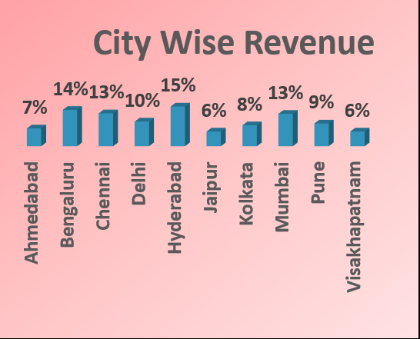
Q11. Which city contributes the highest treatment cost?
Hyderabad contributes the highest revenue by generating 15% of total revenue.

Slide 15
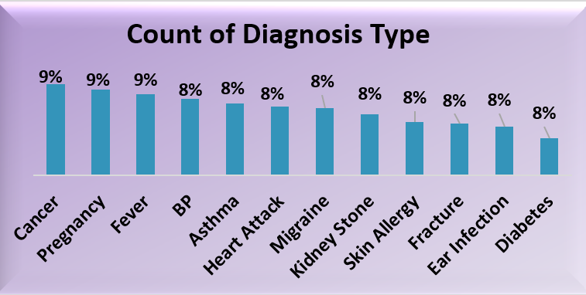
Q12. Which diagnosis is most common across all visits?
Cancer, Pregnancy & Fever are most common diagnosis in across all visits
Those three contributes 9%.

Slide 16
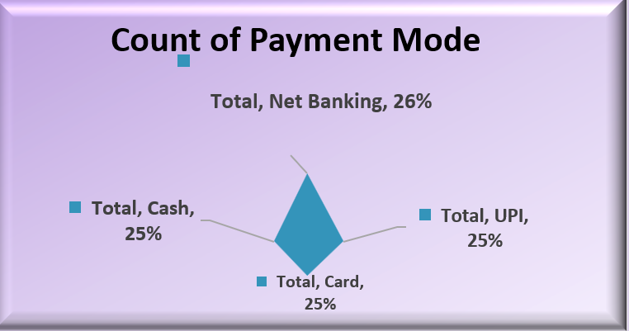
Q13. Which payment mode is most preferred by patients?
Net Banking is Payment mode is most preferred by the Patients, which contributes 26%

Slide 17
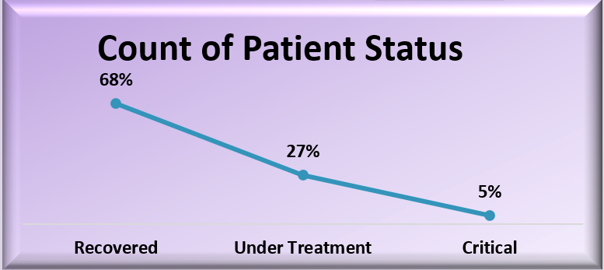
Q14.Which discharge status is most common and what does it indicate?
Most common status is Recovered which contributes 68%,
This shows that the hospital has a high recovery/success rate, meaning most patients are receiving effective treatment and getting discharged in stable condition.

Slide 18
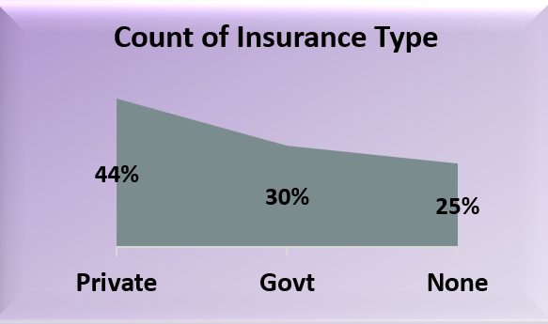
Q15. Which insurance type is used the most and why?
Private insurance type is most used which contributes 44%,
because it provides better hospital coverage, wider treatment benefits, and easier claim availability.

Slide 19


Thank You

